Slide 1
Cloud Solution Design
1. Solution Overview
We design a cloud-native, DAG-orchestrated pipeline using GCP services that automates:
Data ingestion
Data transformation & loading into tables
Report generation
Monitoring & alerting
The solution follows a Bronze – Silver - Gold architecture.
2. End-to-End Automated Flow
Orchestration
- Cloud Composer manages the entire DAG workflow.
- Tasks execute sequentially with dependencies.
- Retries and failure policies are configured.
Data Ingestion
- Composer triggers Cloud Function.
- Cloud Function pulls data from Kaggle API.
- Raw data stored in Cloud Storage (Bronze).

Slide 2
3. Data Transformation and Loading
Composer triggers Dataproc.
PySpark
- Cleans & deduplicates data
- Writes transformed data to Silver bucket
- Loads data into BigQuery staging tables
Warehouse Loading
- BigQuery performs incremental MERGE into Gold tables.
- Fact and dimension tables updated.
4. Reporting
BigQuery View created on Gold tables (Dim + Fact joins)
Looker connects to reporting view.
Dashboards auto-refresh as Gold tables update
5. Monitoring & Logging
Cloud Logging
- Collects logs from Composer, Cloud Function, Dataproc, and BigQuery.
- Centralized troubleshooting.
Cloud Monitoring
- Tracks DAG failures, job failures, runtime metrics.
- Sends alerts (email/Slack) on failure.
The solution is fully automated via Cloud Composer(DAG)

Slide 3
Cloud Components Used
Cloud Component | Service from GCP
Orchestration | Cloud Composer
Ingestion | Cloud Function
Raw Data Storage | Google Cloud Storage (Bronze Layer)
Data Processing | Dataproc
Clean Layer Data | Google Cloud Storage (Silver Layer)
Warehouse | BigQuery (Staging + Gold Tables)
Reporting | Looker
Logging | Cloud Logging
Monitoring | Cloud Monitoring

Slide 4
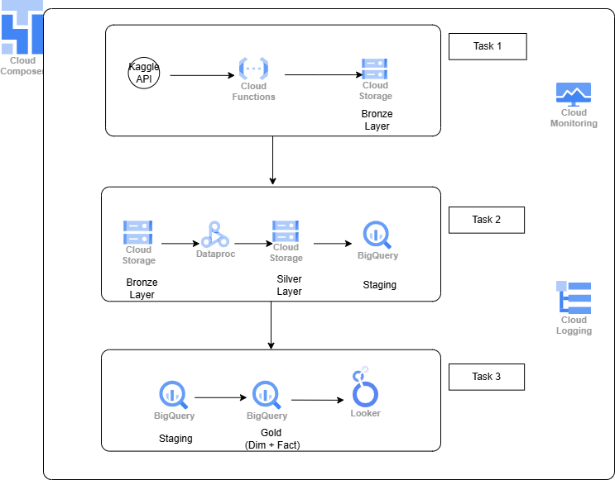
Architecture Diagram

